Slide 1
DICOM & FHIR
Marten Smits
FHIR Developer Days
November 25, 2014

Slide 2
Who am I?
Name: Marten Smits
Company: Furore
Background:
Medical Informatics at University of Amsterdam
Graduating project about FHIR, CDA and DCMs
Now: Developing FHIR Tools at Furore

Slide 3
Outline
DICOM
RESTful DICOM
FHIR ImagingStudy
Use Cases
Demo
Problems

Slide 4
DICOM
Digital Imaging and Communications in Medicine (DICOM)
DICOM is a specification for the creation, transmission, and storage of digital medical image and report data.
Who needs Dicom?
Hospitals, Clinics, Imaging Centers, and specialists.
Notes:
What is it?
What is it used for?
Who uses it?

Slide 5
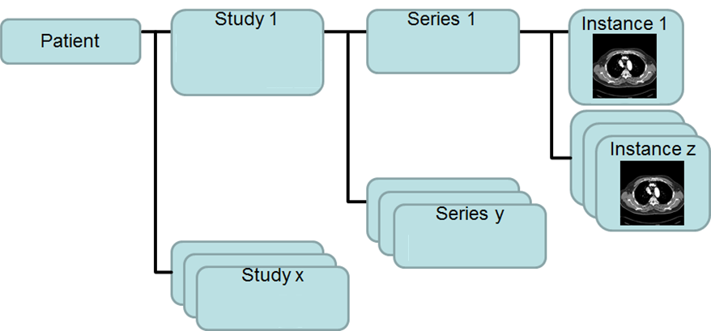
DICOM
Notes:
See it like a photo album with pictures….

Slide 6
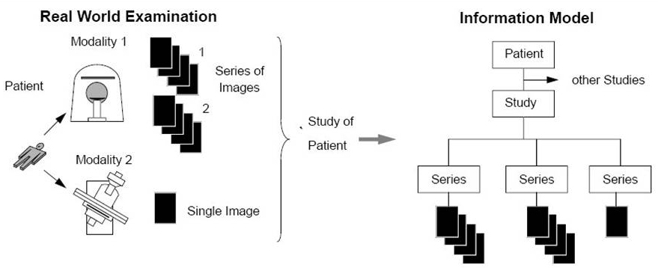
DICOM

Slide 7
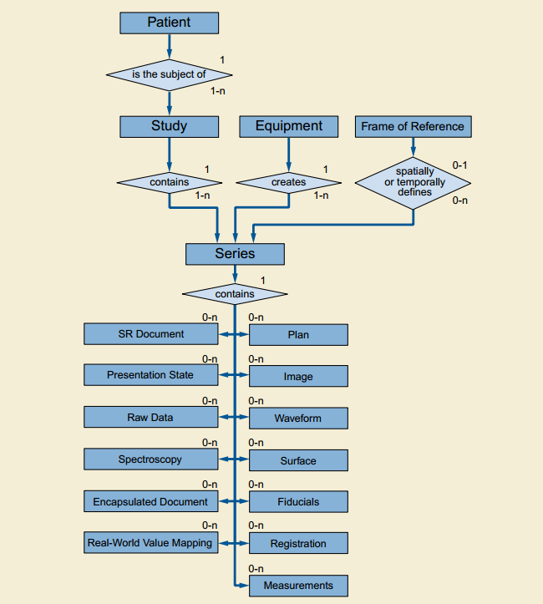
DICOM Structure

Slide 8
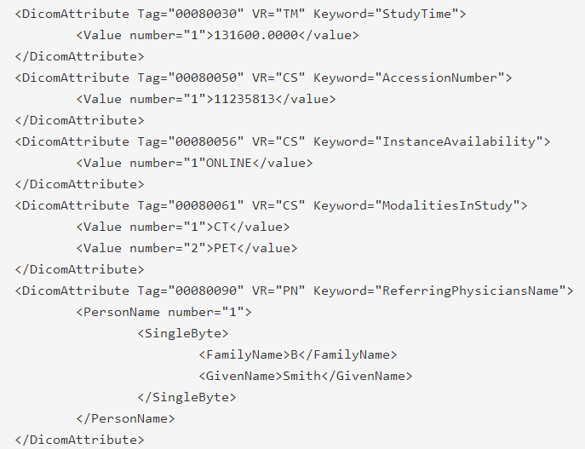
Native Dicom Model
Flat structure (well, some of the datatypes are complex)

Slide 9
Dicom Tags
Unique id for an element of information
Composed of an ordered pair of number (a Group Number followed by an Element Number)
Used to identify Attributes and corresponding Data Elements.

Slide 10
Traditional DICOM transport
Get Image #1
Return Image #1
Get Image #2
PACS
Viewer
Return Image #2
….
Get Image #1000
Return Image #1000
One call and response per image
The same metadata with each image

Slide 11
RESTful DICOM
Get metadata
Return metadata
Viewer
PACS
Viewer
Choose which images you need
Get Image #1-1000
Return Image #1-1000
The same metadata is sent only once
Only one call and response for all images
Notes:
Presentatie Rene

Slide 12
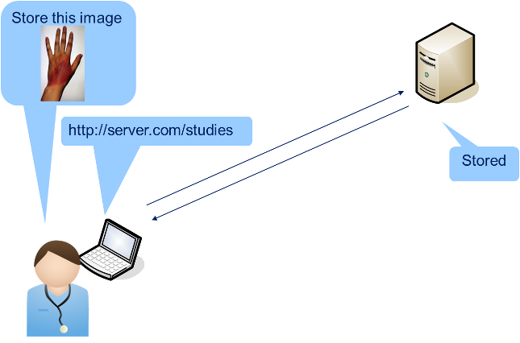
Store (STOW-RS)

Slide 13
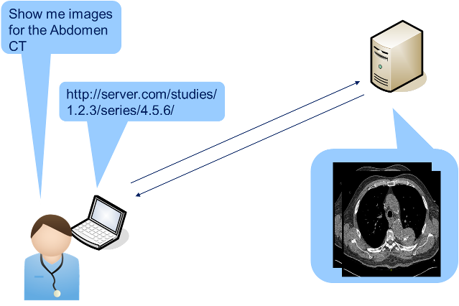
Retrieve (WADO-RS)
Notes:
Web Access to DICOM Objects (WADO) enables you to retrieve specific studies, series and instances by reference.

Slide 14
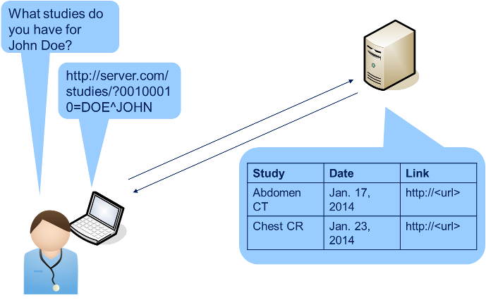
Query (QIDO-RS)
Notes:
Query based on ID for DICOM Objects (QIDO) enables you to search for studies, series and instances by patient ID, and receive their unique identifiers to retrieve the binary representations with WADO.

Slide 15
Query (QIDO-RS)
Look up studies
GET [base-url]/studies?...
Look up series in a study
GET [base-url]/studies/{studyUID}/series?...
Look up series
GET [base-url]/series?...
Look up instances for a study/series
GET [base-url]/studies/{studyUID}/series/{seriesUID}/instances?...
Look up instances by study
GET [base-url]/studies/{studyUID}/instances?...
Look up instances
GET [base-url]/instances?...

Slide 16
QIDO-RS then WADO-RS
QIDO-RS:
GET https://dicomweb.myhospital.com/studies/?00100010=THOMPSON Accept: application/json
Json Response : Add Retrieve URL (0008,1190)
"00081190": { "vr": "UT",
"Value": [ "https://dicomweb.myhospital.com/studies/
1.2.392.200036.9116.2.2.2.1762893313.1029997326.945873" ] }
WADO-RS:
GET https://dicomweb.myhospital.com/studies/
1.2.392.200036.9116.2.2.2.1762893313.1029997326.945873
Accept: multipart/related; type=image/jpeg
Notes:
Sectie van het beeld bij wado
Duidelijk maken dat het een response is

Slide 17
Information Entities (IE)
DICOM IEs can be compared to resources
Patient IE
Study IE
Series IE
Common Image IE (instance)
Notes:
IODs worden gedfineerd in termen van Information Entites (IE), die op hun beurt weer bestaan uit 1 of meer modules (die elk weer bestaan uit 1 of meet attributen). IEs zitten het dichtst bij de granulariteit van Resources.
DICOM Part 3, appendix C sectie 7.2 beschrijft bijvoorbeeld de Study IE,
C.7.3 de Series IE, C.7.6 Common Image IE (als generieke instance).
Wellicht dat andere IEs in appendix C voor je van belang zijn, zoals Modality.
Definite tabellen van IEs bevatten een kolom 'Type', die de waarde 1 (mandatory), 2 (verplicht indien bekend bij zender, ook bekend als 'RE'
in IHE en HL7 v2) en 3 (optioneel).

Slide 18
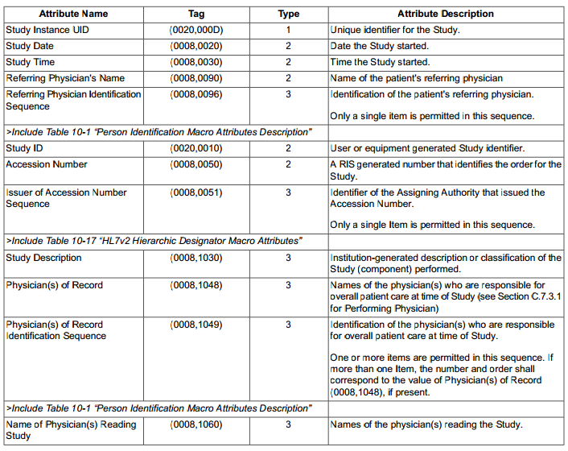
Information Entities (IE)

Slide 19
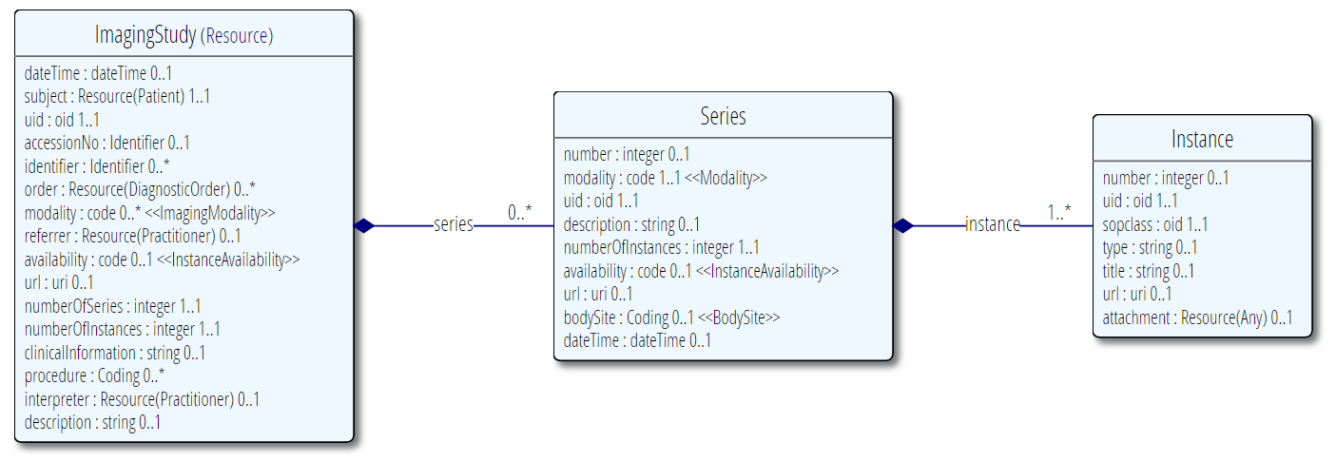
FHIR ImagingStudy
Biggest difference: Granularity
Notes:
This resource summarizes a series of images or other instances generated as part of an imaging study, and provides references to where the images are available using WADO-RS. This resource is used to make information concerning images etc. that are available in other clinical contexts such as diagnostic reports, Care Plans, etc. Also, see the use case description below.
This resources has been specifically designed with use in DICOM contexts in mind. The content is closely based on the definitions of the equivalent DICOM constructs, and informed by usage patterns already established through DICOM implementation practices, including XDS-I. It is not, however, necessary to use DICOM infrastructure in order to use this resource.
First: A list of all the Series.ImageModality values that are actual acquisition modalities
Second: The modality of this series sequence.
Uri: WADO-RS
Uid: Indentifier

Slide 20
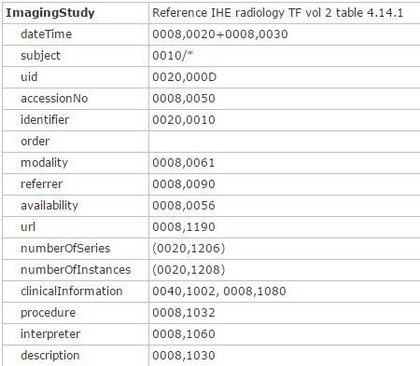
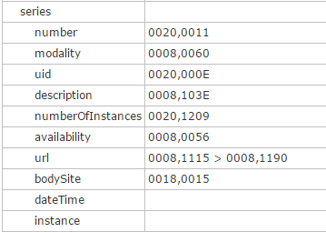
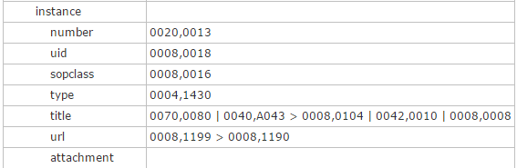
ImagingStudy and DICOM
http://hl7.org/implement/standards/fhir/imagingstudy-mappings.html

Slide 21
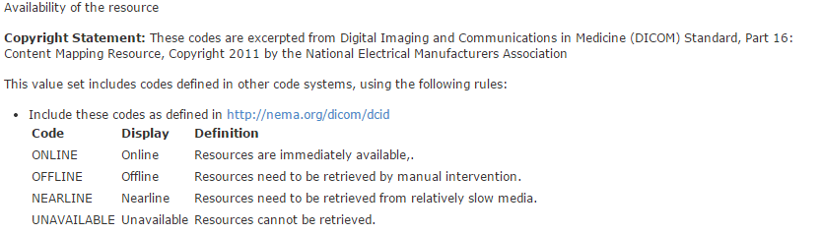
FHIR ValueSets
ValueSets are also based on DICOM:
Modality
Availability
ImageModality

Slide 22
QIDO on FHIR?
QIDO-RS
Query
FHIR Server with QIDO-RS endpoint
Native Dicom Model Objects
ImagingStudy
Resources
Notes:
QIDO-Queries omzetten naar FHIR?

Slide 23
FHIR on QIDO?
FHIR Search
PACS with FHIR endpoint
FHIR Resources
Dicom Native Models
Notes:
QIDO-Queries omzetten naar FHIR?

Slide 24
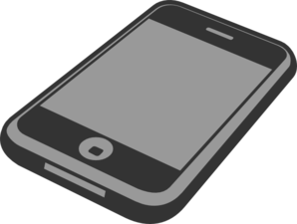
Why would we want this?
PACS
DICOM web
FHIR Server with QIDO-RS
DICOM web
Mobile app that speaks DicomWeb, doesn’t need to speak FHIR as well
Notes:
EHR geen Dicom hoeft te praten, en al FHIR kan….
Here a picture with an EHR that talks FHIR and DICOM…

Slide 25
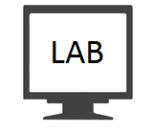

Why would we want this?
FHIR
PACS
with FHIR search
FHIR
The EHR doesn’t need to speak DICOM anymore.
Notes:
EHR geen Dicom hoeft te praten, en al FHIR kan….
Here a picture with an EHR that talks only FHIR…

Slide 26
Dicom Serialization
FHIR ImagingStudy to Dicom Attributes
34 data types need to be converted
For example:
DateTime -> date+time
Notes:
Add slide with some examples in code

Slide 27
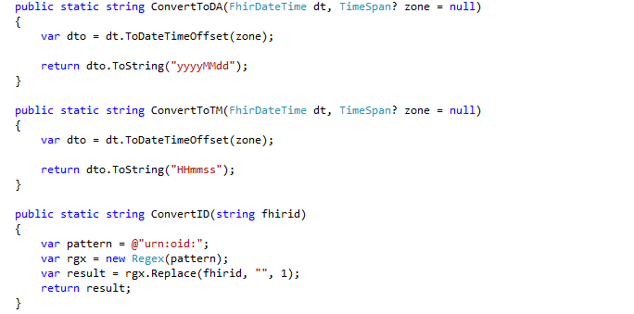
Code Examples

Slide 28
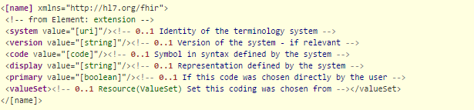
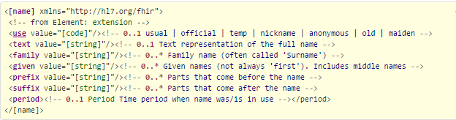
Serialization
Complex Datatypes
Coding
HumanName
Notes:
Add Slide with Dicom Coding and Human Name

Slide 29

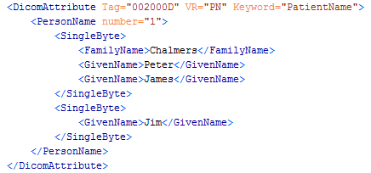
Serialization
Complex Datatypes
Coding
HumanName
Notes:
Add Slide with Dicom Coding and Human Name

Slide 30
Serialization
Data from other resources
Patient
Practitioner
Referenced
Retrieve referenced resource for information
DICOM to FHIR?
Contained??

Slide 31
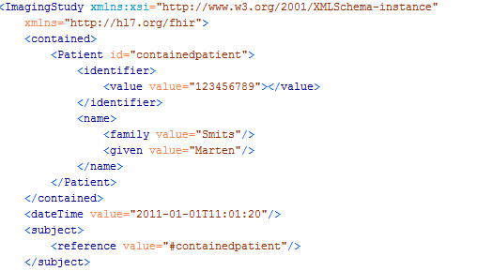
Serialization
Contained Resources
Dicom -> FHIR
Don’t need a patient endpoint
However: patient cannot be reused

Slide 32
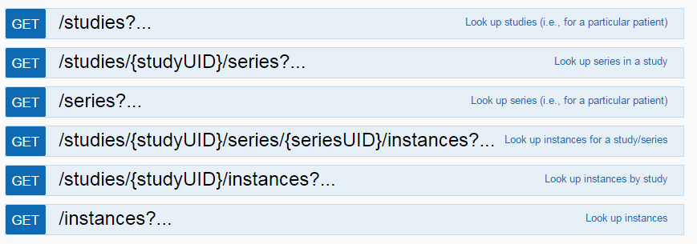
QIDO Endpoints
Created QIDO Endpoints in FHIR
ImagingStudy based on QIDO-RS call
Notes:
Visueel

Slide 33
Differences FHIR and DICOM
DICOM: GET /Instance?SOPInstanceUID=certainoid
Returns only one instance
FHIR: GET /ImagingStudy?|urn=certainoid
Searches for the imaging study with a certain instance oid
Return the entire ImagingStudy with all it’s instances
FHIR doesn’t return partial resources

Slide 34
QIDO Endpoints
GET /Studies?
Return all ImagingStudy resources
GET /Series?
Return all series components from all ImagingStudy resources
GET /Instances?
Return all instances from all series from all ImagingStudy resources
Notes:
Slide toevoegen over ImagingStudy search als jij DICOM hebt…

Slide 35
Demo

Slide 36
Problems
DICOM and FHIR don’t share the same mandatory fiels
This could result in invalid DICOM or FHIR when a mandatory field is not present in the source
Notes:
Dicom allows search on all parameter, fhir op slechts een aantal
Minimal search parameter on DICOM Native model in FHIR? No….

Slide 37
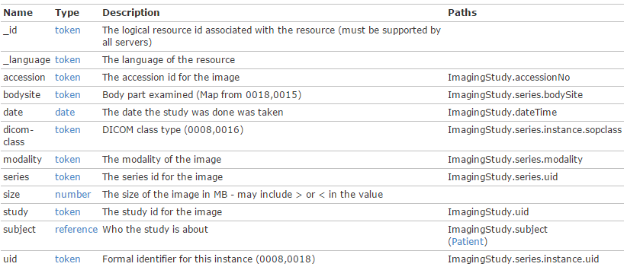
Problems
Dicom allows search on all parameter, FHIR on just a few

Slide 38
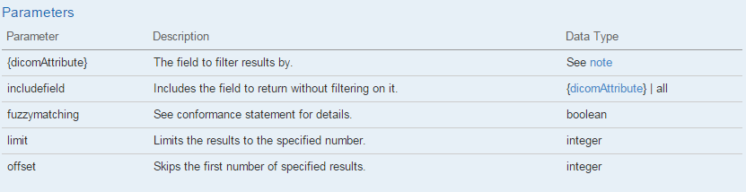
Problems
Not all QIDO-RS parameters implemented yet

Slide 39
Discussion and Questions?
Contact:
Marten Smits
Furore, The Netherlands
m.smits@furore.com

